Slide 1

LAB SQL 02 Database(s): salesshort Lab goals. Use the SELECT, WHERE, ORDER BY, LIMIT clauses using either your local MySQL Community Server instance or the on-premise MySQL server at Leeds. If you use your local MySQL Community Server instance, you will need to load the salesshort database into your local instance using the .sql file: DB02 salesshort.sql. Remember to select ‘Don’t Limit’ to ensure your query results are not being limited to the first 10, 50, 100 rows, etc…
If you are still troubleshooting any part of the MySQL installation process and/or connection to the MySQL server instance at Leeds, please reference this PowerPoint. You can also use MySQL in phpMyAdmin as a demo.
MSBX-5405
Originally created by: Dr. Karina Hauser
Modified by: Keith Sparling

Slide 2
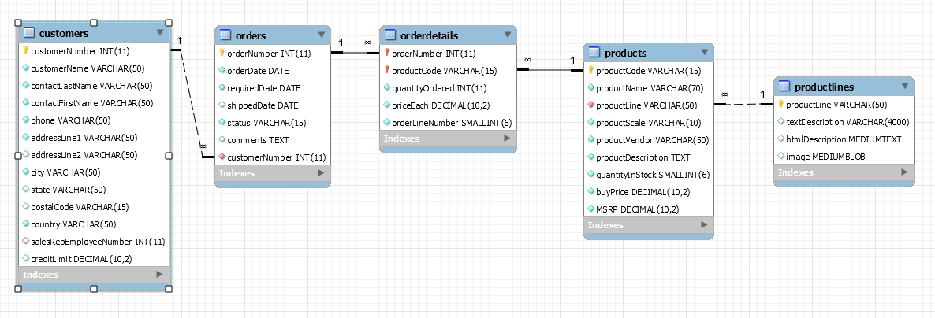
ER Diagram for SalesShort Database

Slide 3
LAB SQL 02 Save a .sql script labeled: lab02_”your IdentiKey” (for example: lab02_kesp5555)
Show the customerNumber, customerName, city, state, and country for all customers from the country ‘Germany.’ Order by customerName (A-Z).
Show everything from the products table where ‘Harley’ is somewhere in the productName. Order by productLine (A-Z), then by quantityInStock (lowest to highest).
Show productCode, productName, and margin (msrp – buyPrice). Show only the products with margins greater than 50. Order by margin (highest to lowest).
Show everything from the orders table that have a comment (i.e., do not include missing comments, comments with NULL values).
Show everything from the orders table where the status is not ‘Shipped.’

Slide 4
LAB SQL 02 Save a .sql script labeled: lab02_”your IdentiKey” (for example: lab02_kesp5555)
Show everything from the products table where ‘Car’ is somewhere in the productLine. Then, order by MSRP (largest to smallest). Show only the first twenty rows.
Show customerName, contactFirstName, contactLastName, and creditLimit where the contactFirstName only has 5 characters (i.e., 5 characters exactly, spacing not included). Order by contactLastName (A-Z). You should use a TRIM function around contactFirstName in your SELECT statement to remove any leading and/or trailing spaces from this string field. You should also use the TRIM function, TRIM(contactFirstName), with your WHERE clause to ensure you filter on people with only 5-character first names. There are a few ways to solve for this.
Show productName, productLine, and productDescription where the productScale is 1:10. Order by productLine (A-Z), then order by productName (Z-A).
Show everything from the orderdetails table where the ‘Total Price’ (quantityOrdered * priceEach) is greater than 500 and lower than 1000 (i.e., between 500.01 and 999.99). Order by ‘Total Price’ in descending order.
Show everything from the customers table where the customer is from the country USA with a creditLimit greater than 100000.

Slide 5
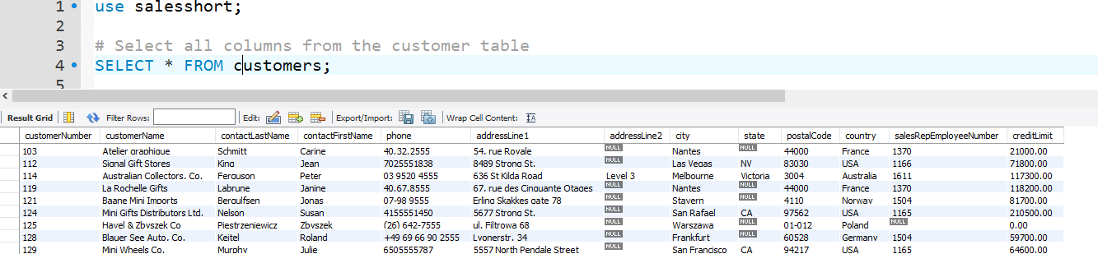
Submit the following:
One .sql file with your 10 SQL scripts.
A word document, PDF, or PowerPoint with screenshots of your SQL code and the first 10 - 20 lines of output for each of your 10 SQL scripts (i.e., select statements). Example:
This lab assignment will be reviewed by two peers, taking the average score from these two peer reviews, based on (1) the ability to execute/run each select statement and (2) the “recommended” output for each select statement.

